Slide 1


Facial Attendance System
Supervised By: Er. Shiva Kumar Shrestha
Prepared By:
Amar Nagaju (730305)
Anirudh Basukala (730307)
Manish Kharbuja (730319)
Manish Nhuchhe (730320)
Sunder Tamakhu (730345)
17 March 2021

Slide 2
Introduction
Attendance being one of the major factor in colleges, the manual attendance at present is time consuming and error prone.
Automated attendance system uses face recognition system to record the attendance of students.
Face detection technique is widely being used in face unlock system and in cameras at present.

Slide 3
Motivation
Image processing and deep learning is to reach its peak.
Automated attendance helps to remove the error by assisting teachers.
Statement of Problem
Difficult and time consuming to take in attendance through traditional method.
Students may answer in turn of their absent friends

Slide 4
Objective
To detect, recognize and record personnel in a user-friendly interface.
Scope
In keeping a record of attendance of staffs in schools and colleges.
In keeping a record of students in educational and other institutions.
In surveillance presence of people in college premises.

Slide 5
Literature Review
Face Detection
Face Recognition
Transfer Learning
VGG-16
Facial Attendance

Slide 6
Requirement Analysis
Software requirement
Hardware requirement
Functional requirement
Non-functional requirement
Reliability
Accuracy
Maintainability
Portability
Performance
Frames Per Second

Slide 7
Feasibility Study
Technical Feasibility
Operational Feasibility
Economic Feasibility

Slide 8
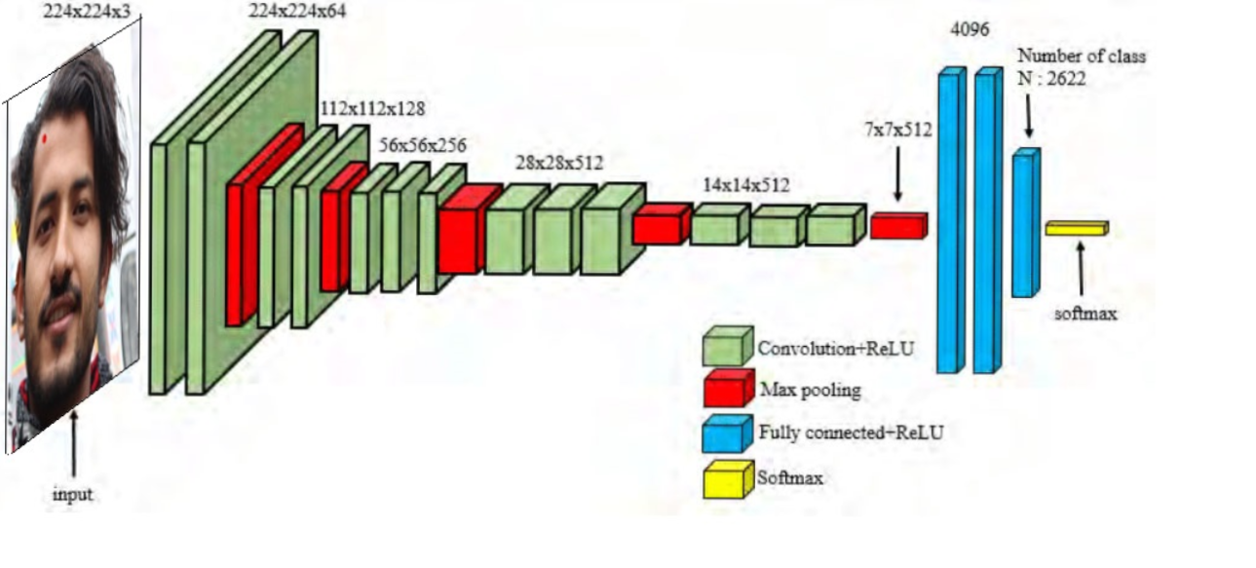
Architecture
Fig: Architecture of Face Recognition System

Slide 9
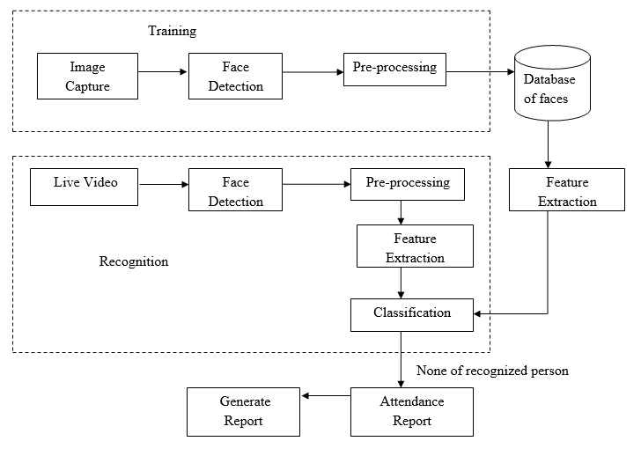
Block Diagram
Name
Fig: Block Diagram of Facial Attendance System

Slide 10
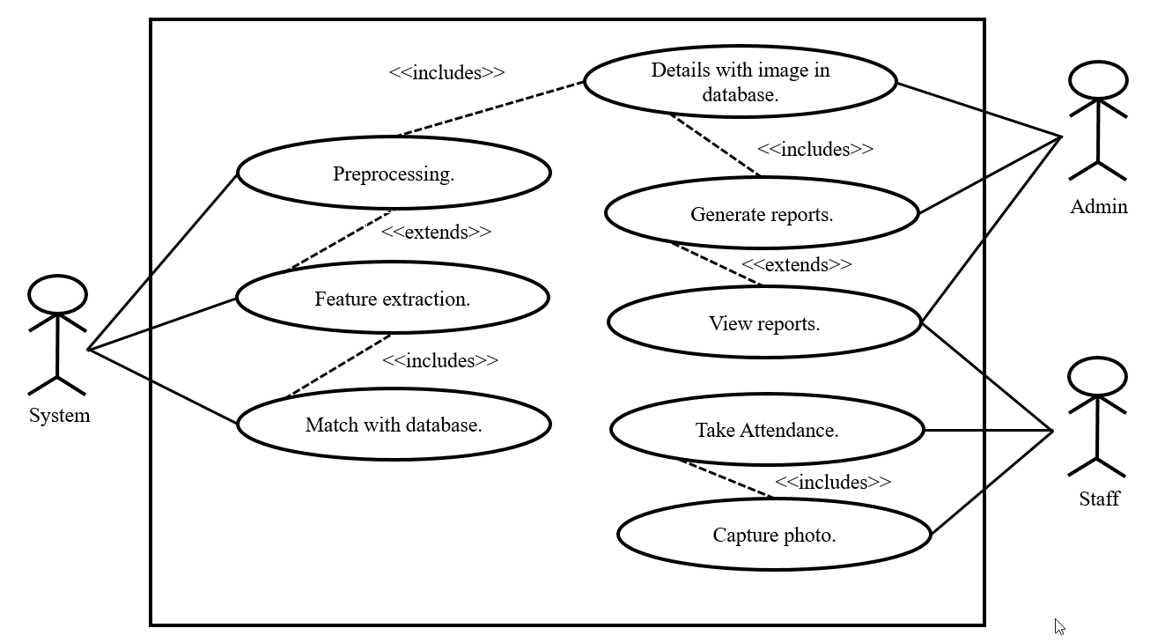
Use-Case Diagram
Fig: Use Case Diagram of Facial Attendance System

Slide 11
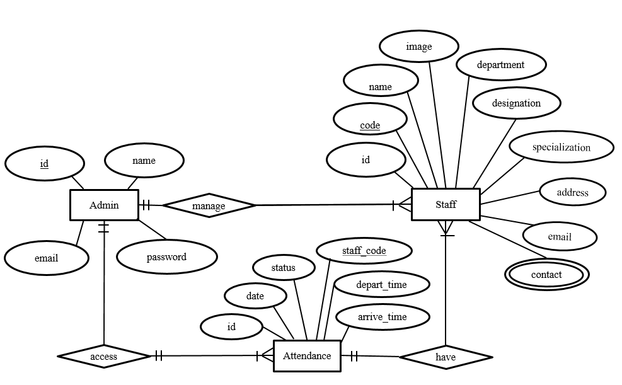
ER Diagram
Fig: ER Diagram of Facial Attendance System

Slide 12
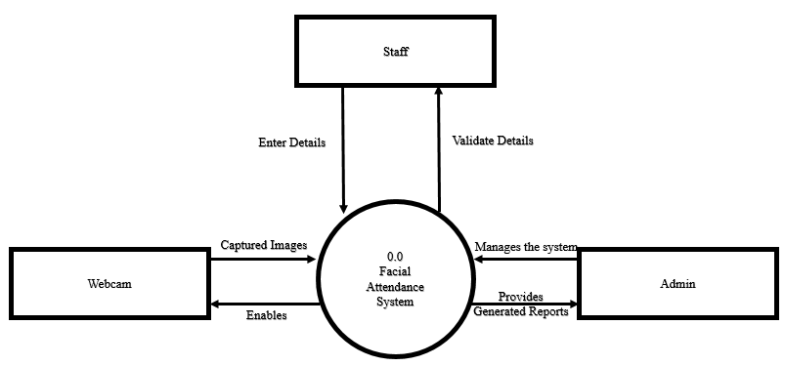
Context Diagram
Fig: Context Diagram of Facial Attendance System

Slide 13
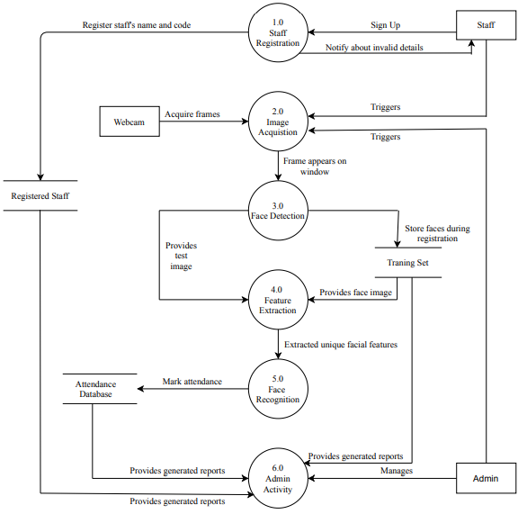
Data Flow Diagram
Fig: Data Flow Diagram of Facial Attendance System

Slide 14
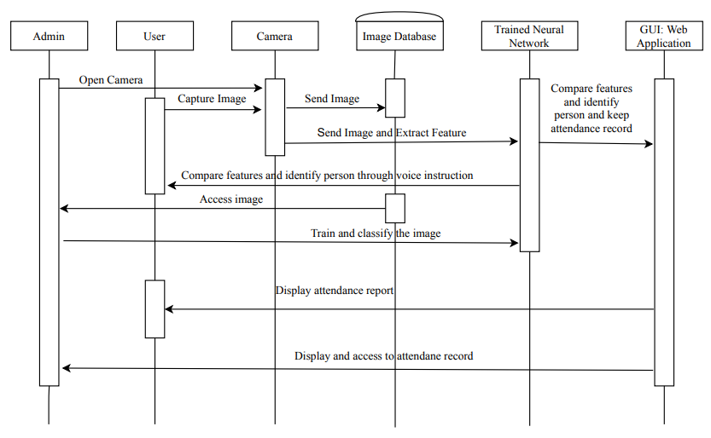
Sequence Diagram
Fig: Sequence Diagram of Facial Attendance System

Slide 15
Methodology
Data Augmentation
Rotation, scaling, zooming, horizontal flip
Parameter Selection
Image size: 224*224
Batch size: 25
No. of epochs: 20
Learning rate: 0.0001
Activation Function: ReLU
Dataset Selection

Slide 16
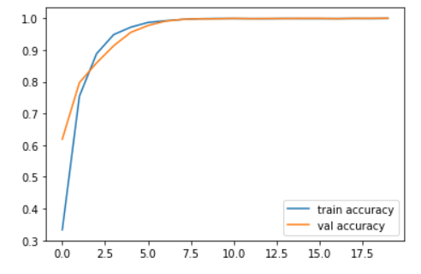
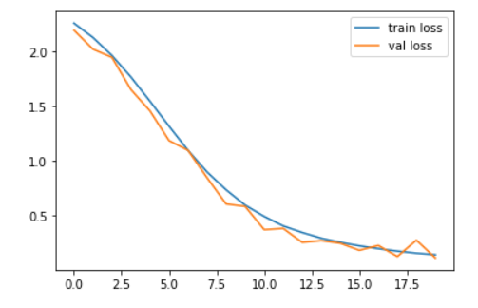
Experimental Analysis of Dataset 1
Fig: Accuracy and Loss Graph of Dataset 1

Slide 17
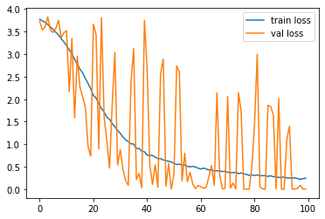
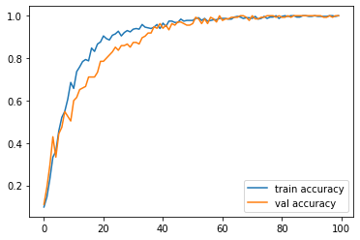
Experimental Analysis of Dataset 2
Fig: Accuracy and Loss Graph of Dataset 2

Slide 18
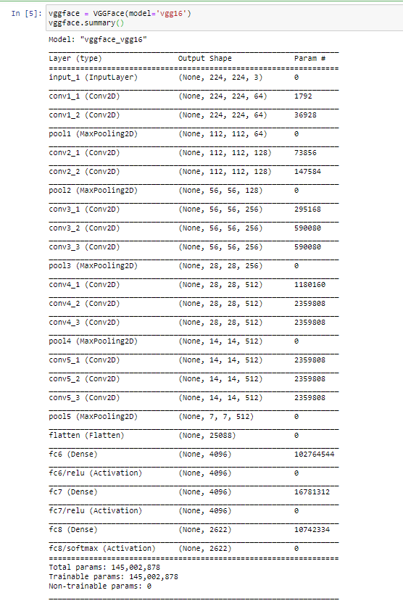
Work Done
Fig: Model Architecture of Face Recognition Model

Slide 19
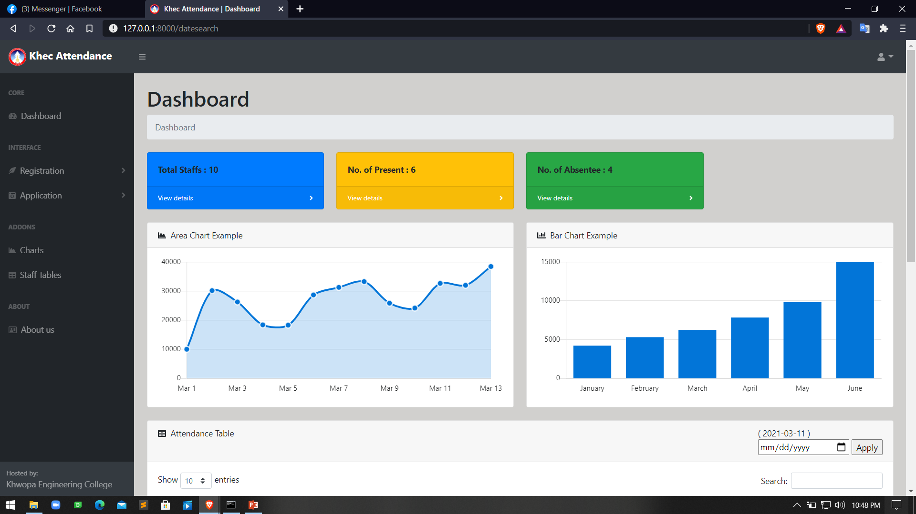
Work Done
Fig: Web Framework Dashboard

Slide 20
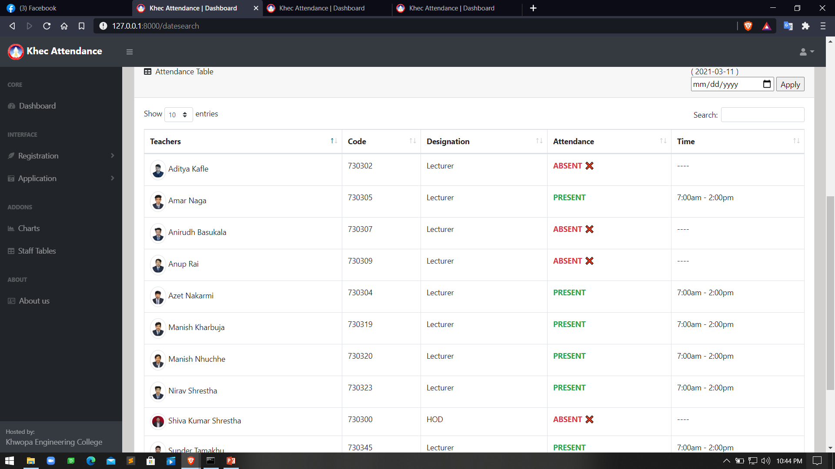
Work Done
Fig: Viewing the data in web framework

Slide 21
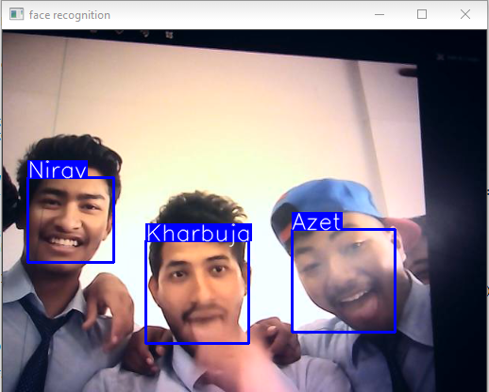
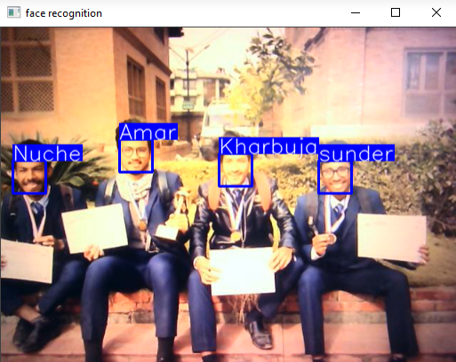
Test Result
Fig: Test result for face recognition

Slide 22
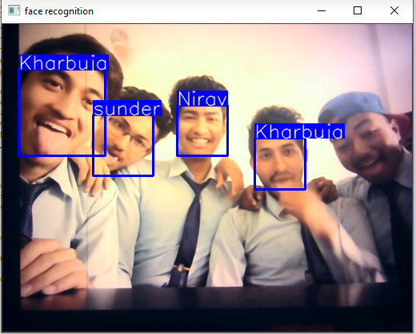
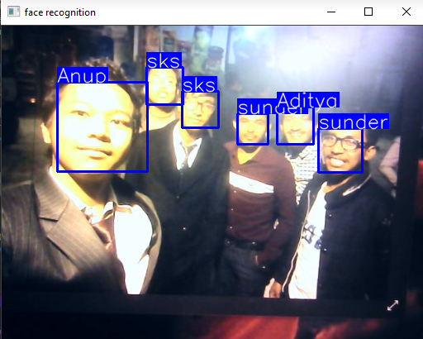
Failed Cases
Fig: Failed prediction of the face recognition model

Slide 23
Work to be done
Login for a user to see their attendance report
Admin page completion
Train model with more dataset
Add alert when personnel is recognized and recorded
Email notification for absentees

Slide 24
Reference
Hongling Chen and Chen Haoyou, “Face Recognition Algorithm Based on VGG Network Model and SVM”, IOP Conf. Series: Journal of Physics: Conf. Series 1229 (2019) 012015 IOP Publishing doi:10.1088/1742-6596/1229/1/012015, [Accessed: 28thFebruary, 2020]
Zhao Pei, Hang Xu, YanningZhang, Min Guo and Yee-Hong Yang, “Face Recognition via Deep Learning Using Data Augmentation Based on Orthogonal Experiments”, 25 September 2019. [Visited Date: 28th February 2020]
SrikanthTammina, "Transfer learning using VGG-16 with Deep Convolutional Neural Network for Classifying Images", Electrical Engineering, Indian Institute of Technology, Hyderabad, 2017 [Accessed: 28th February 2020]
Mei-Xiang Zhao, Zhi-Gang Jia, Dunwei Gong "Sample-Relaxed Two-Dimensional Color Principal Component Analysis for Face Recognition and Image Reconstruction", [Accessed: 28th February 2020]
MengjiaYan Horizon Robotics, Qian Zhang Horizon Robotics, Guoli Wang Horizon Robotics, ZiningXu Horizon Robotics "VarGFaceNet: An Efﬁcient Variable Group Convolutional Neural Networkfor Lightweight Face Recognition", [Accessed: 3rd March 2020]
Felipe L. Gewers, Gustavo R. Ferreira, Henrique F. de Arruda, Filipi N. Silva, Cesar H. Comin, Diego R. Amancio, and Luciano da F. Costa1 "Principal Component Analysis: A Natural Approach to Data Exploration”, [Accessed: 10th February 2020]
Grigorios G. Chrysos, Stanlianos Moschoglou, Giorgos Bousitsas, Jiankang Deng, Yannis Panagakis, Stefanos Zafeiriou, "Deep Polynomial Neural Network", 2021
J. Deng, J. Guo, Y. Zhou, J. Yu, I. Kotsia, and S. Zafeiriou, “Retinaface: Single-stage dense face localization in the wild “, 2020

Slide 25
Thank You!

